Slide 1
SendInBlue Email Slide

Slide 2
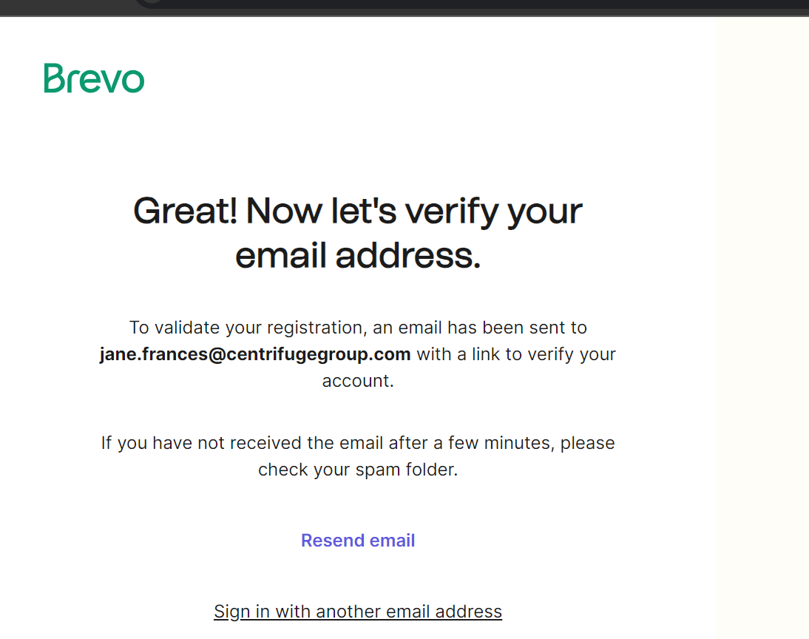
Email Verification.

Slide 3
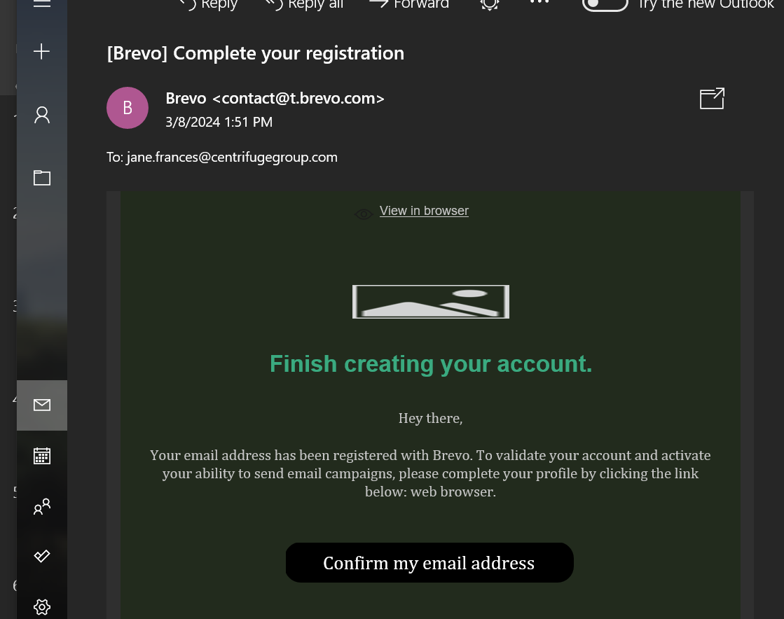
Email Verification Link.

Slide 4
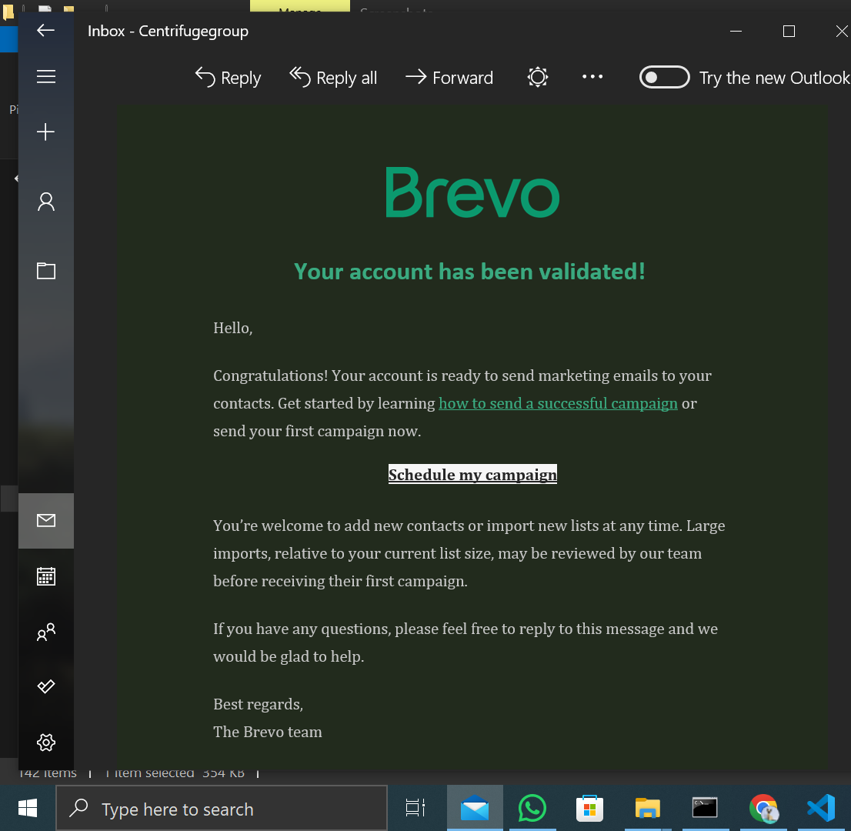
Account Verified.

Slide 5
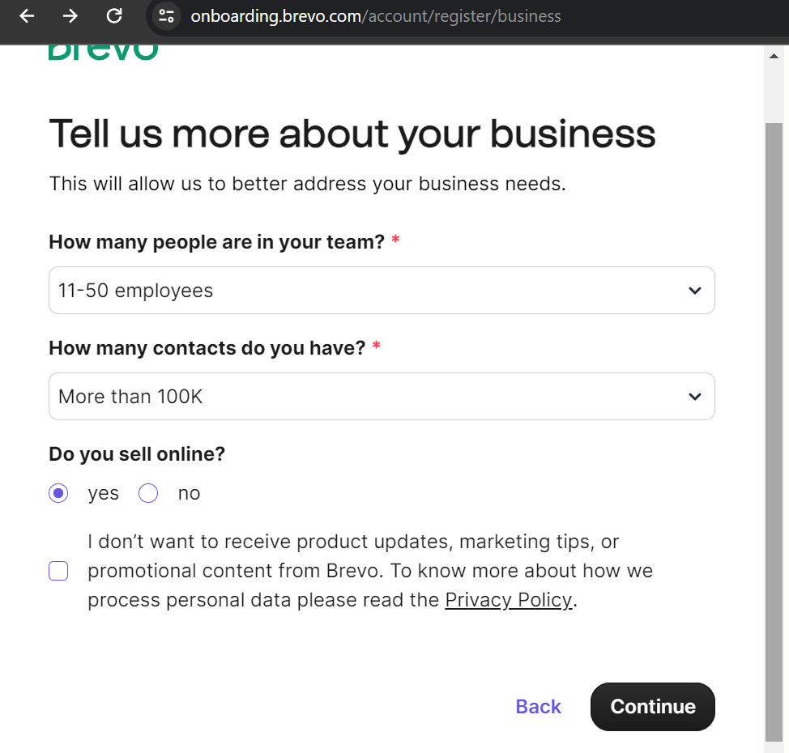
Know your Customer.

Slide 6
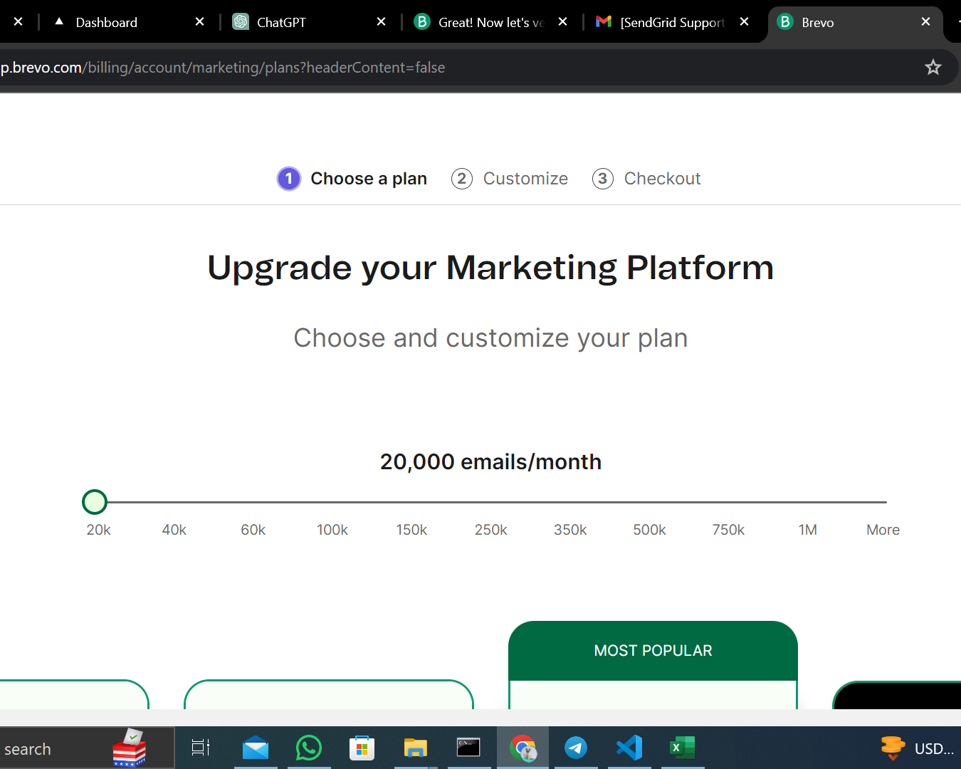
Beginning Of Pricing Plan

Slide 7
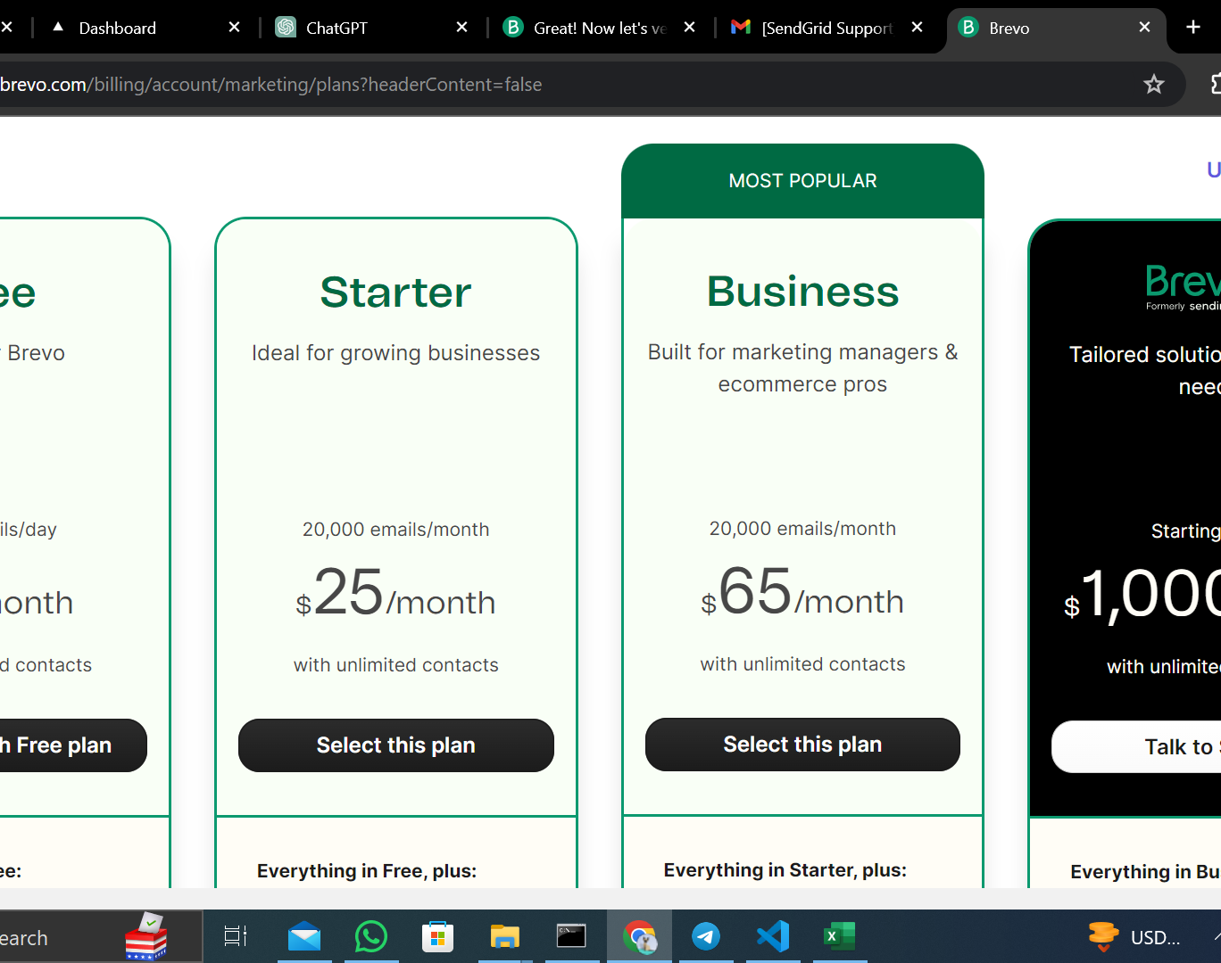
Pricing Plan.

Slide 8
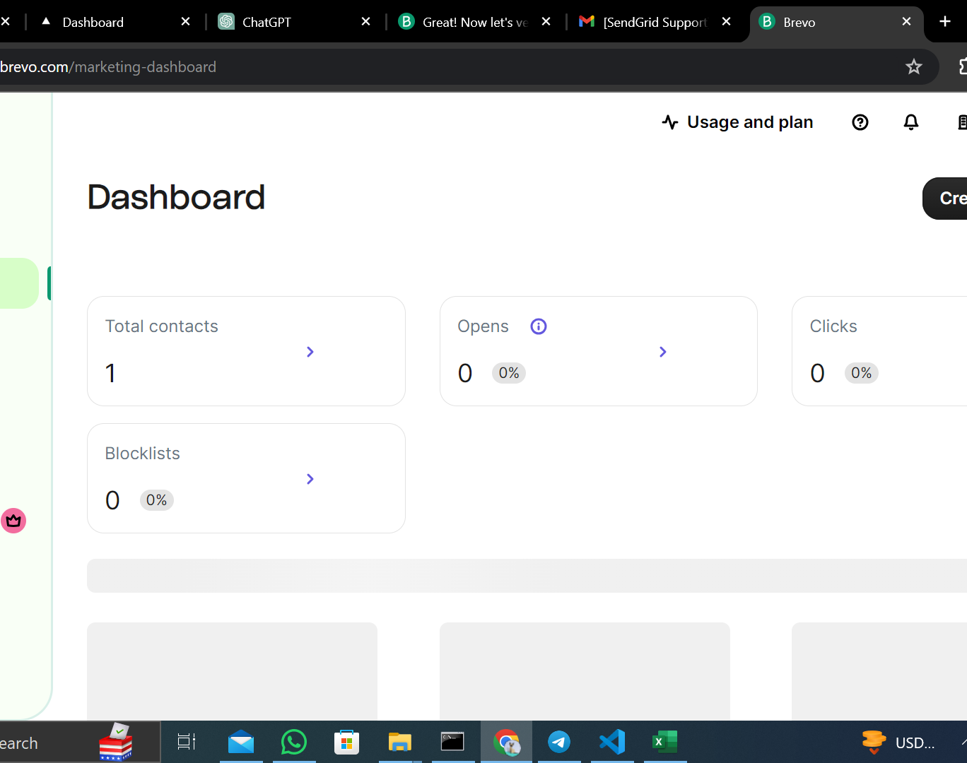
From the Pricing page, this is the next page.

Slide 9
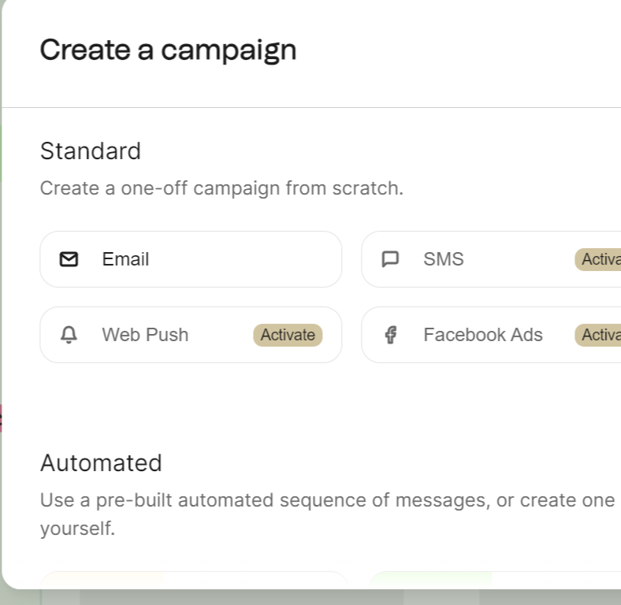
Create a campaign

Slide 10
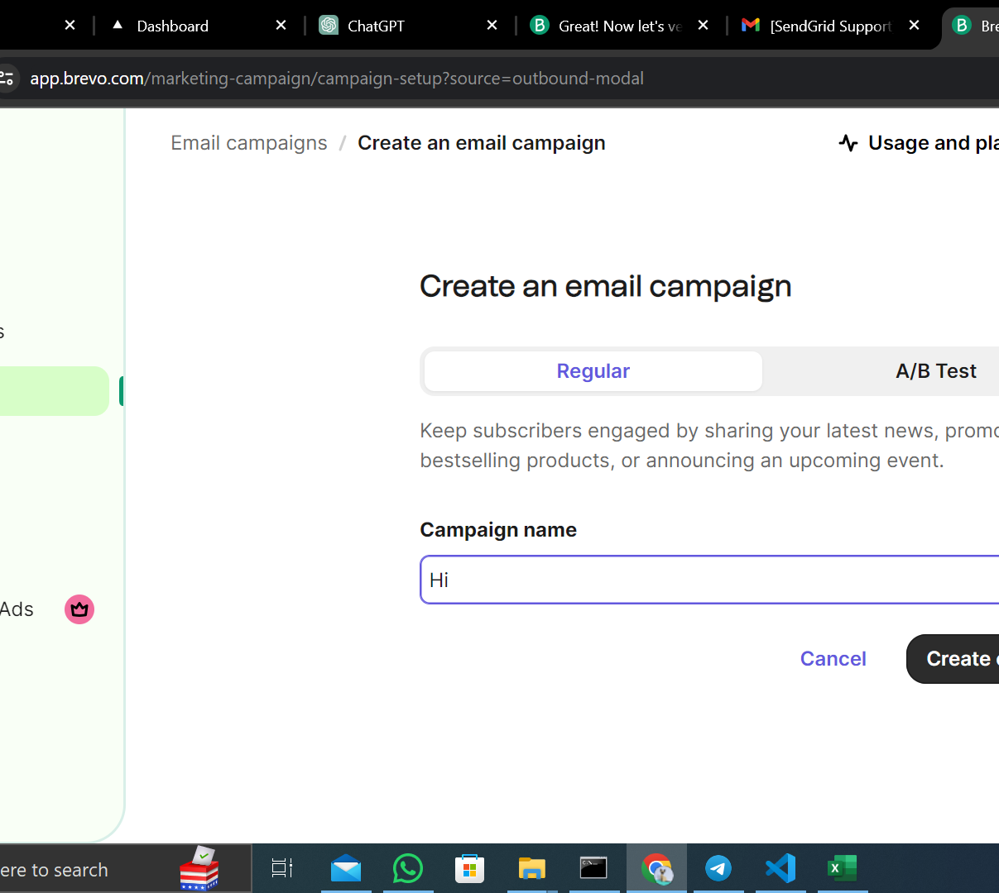
Email creation

Slide 11
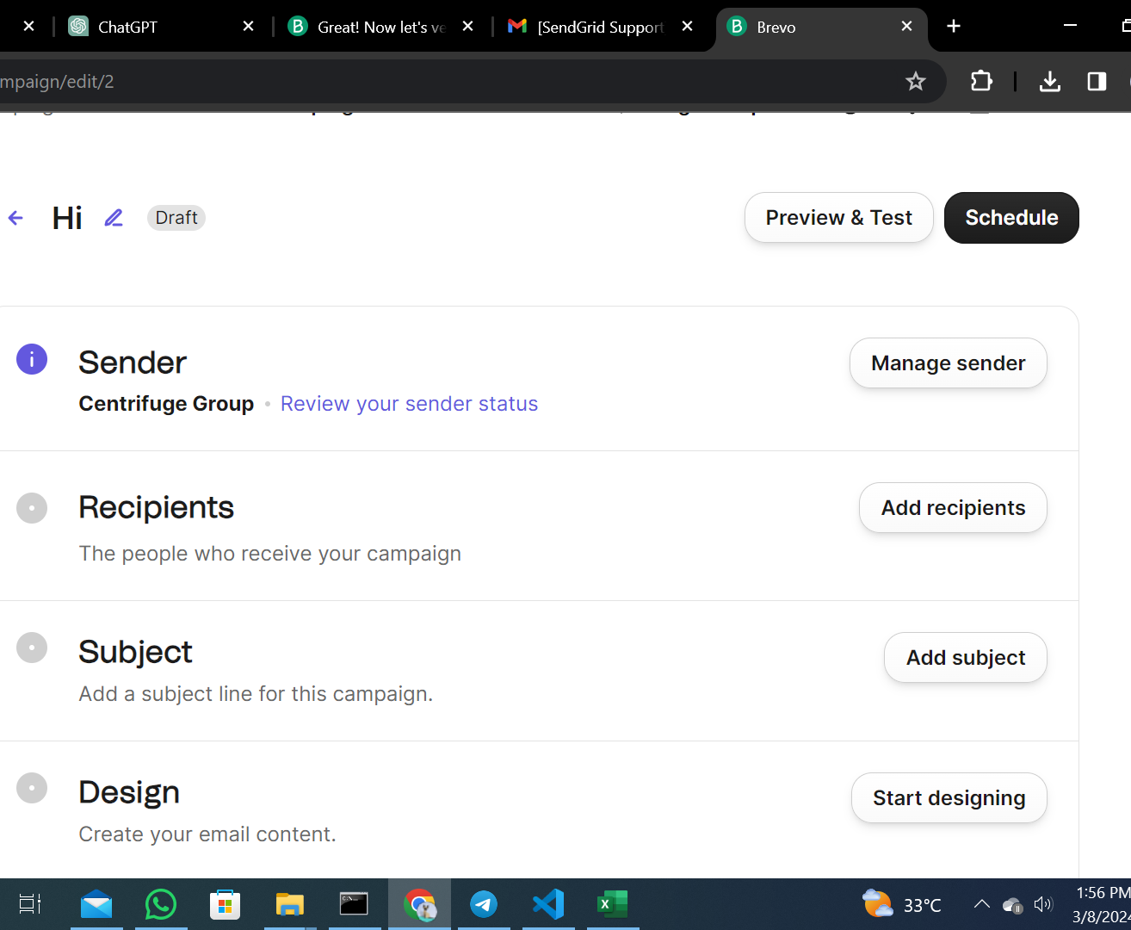
Email Address Setting.

Slide 12
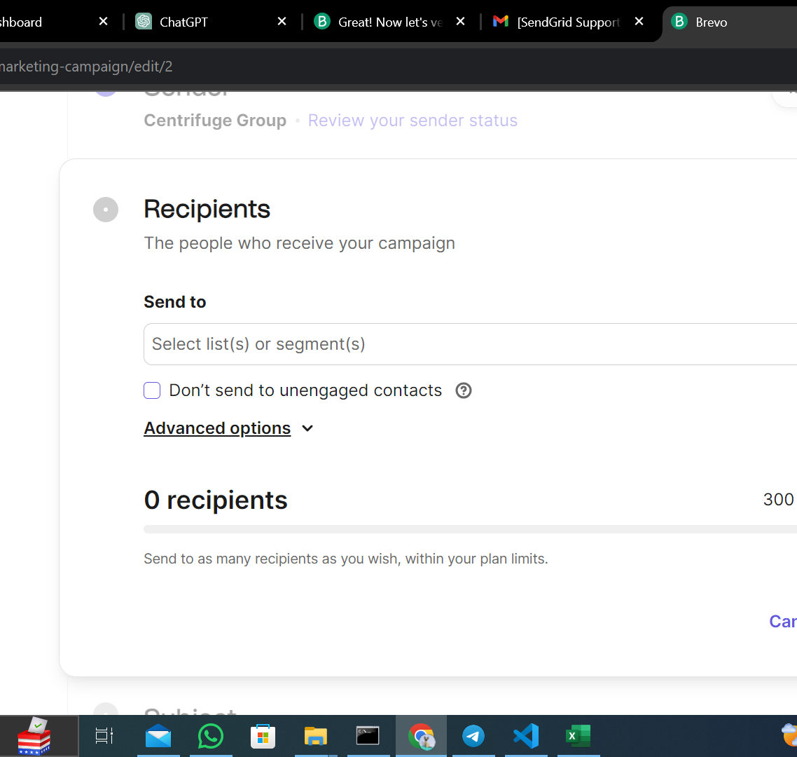
Adding Recipients.

Slide 13
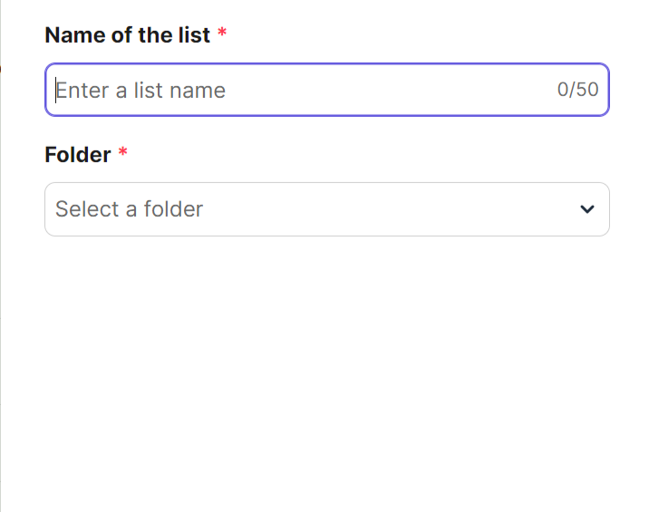
Create a list.

Slide 14
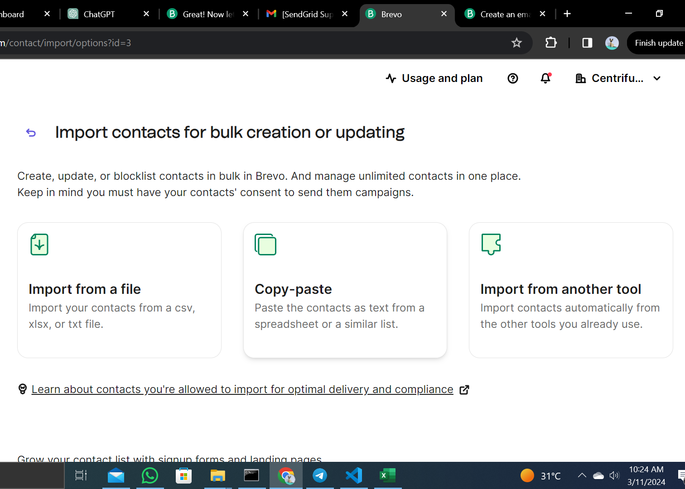
Importing Contacts.

Slide 15
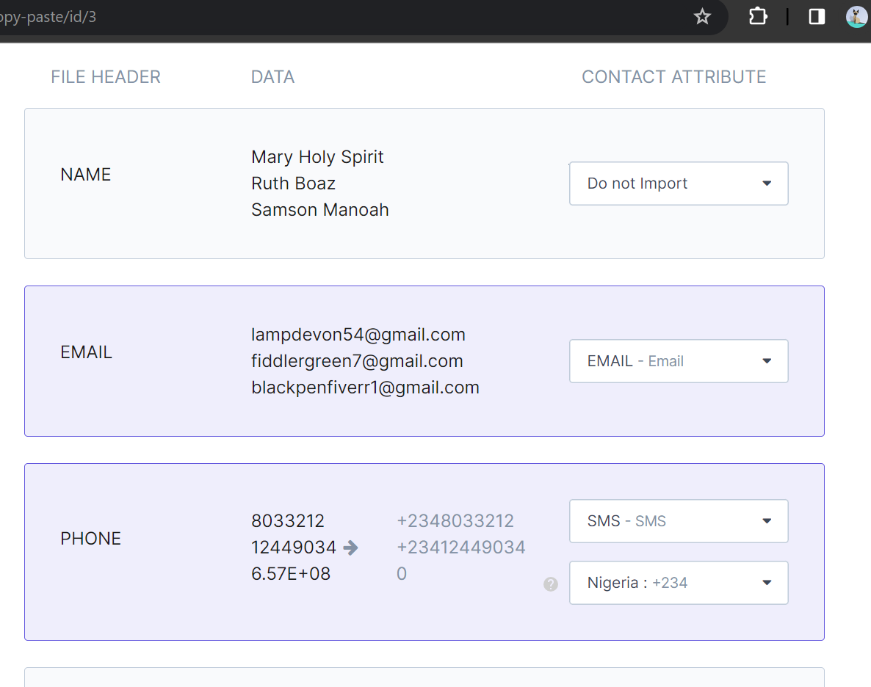
After some prompts, SendInBlue groups the recipients like this:

Slide 16
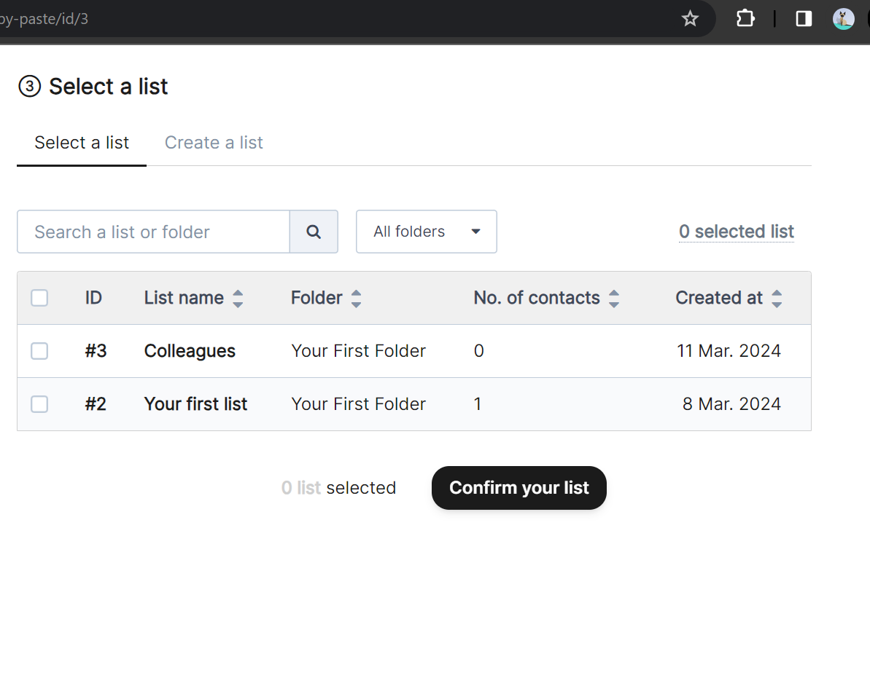
Recipients are grouped into folders.

Slide 17
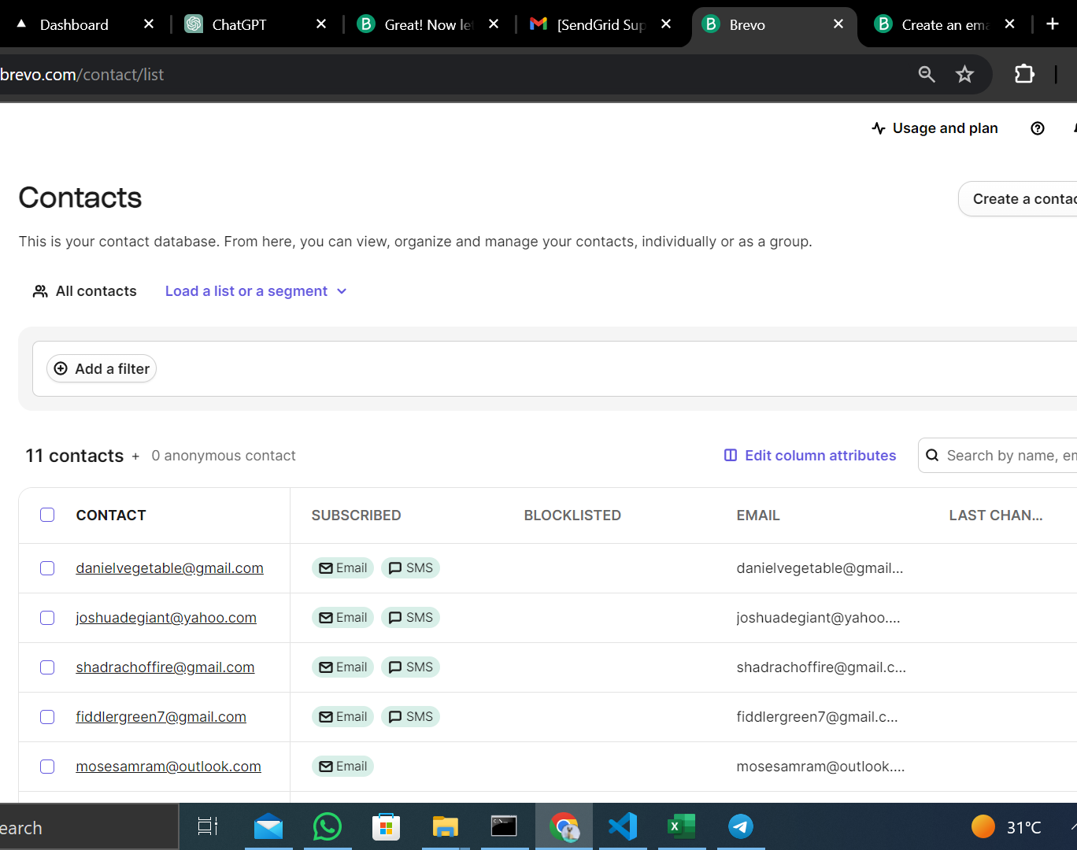
Last setting prompt before you can save the recipients list

Slide 18
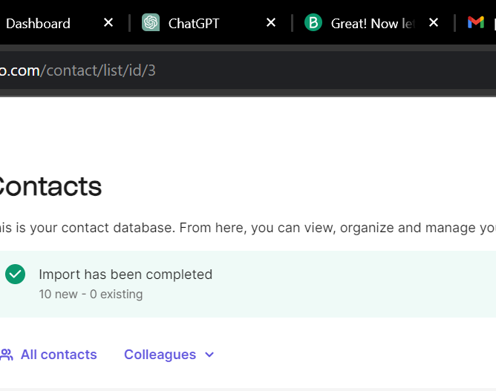
Import Successful.

Slide 19
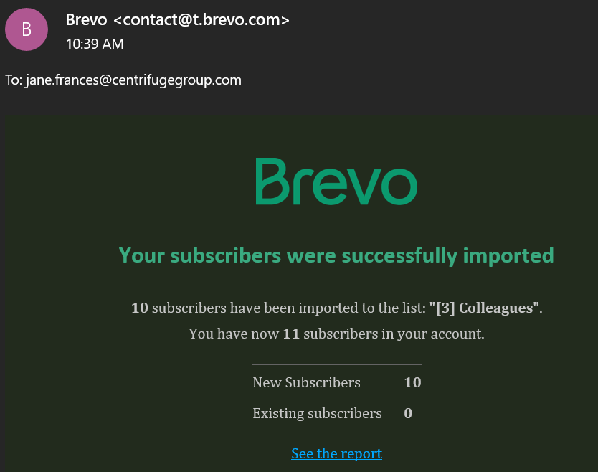
Email confirming imports of Recipients.

Slide 20
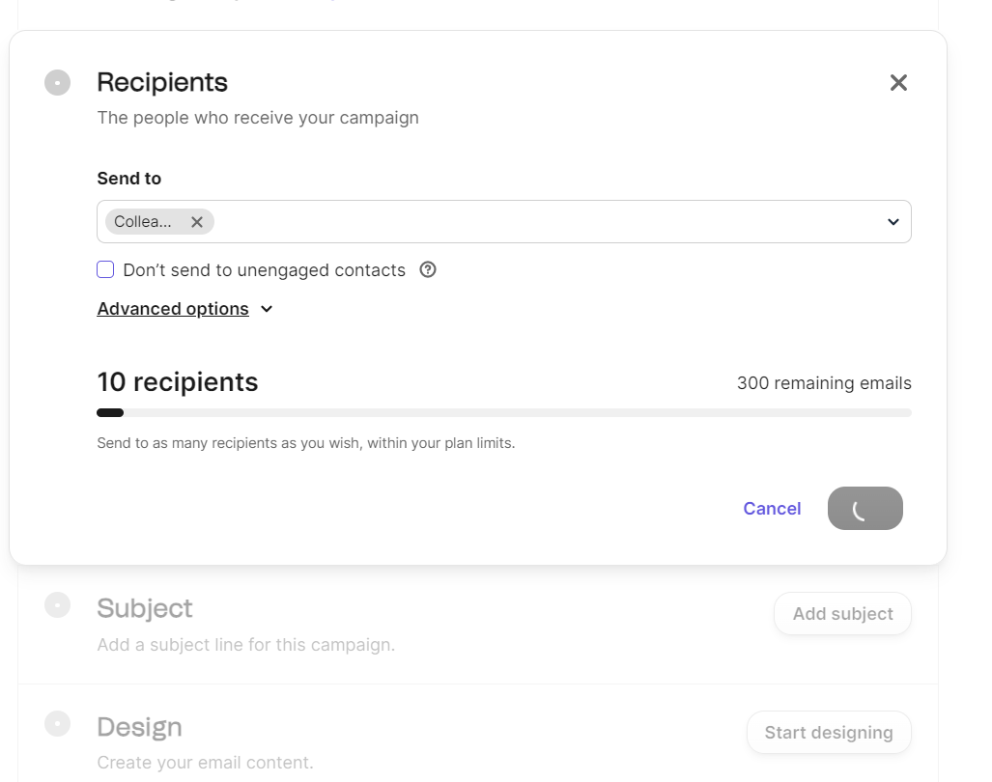
After the recipients Import, the recipients tab changes to this.

Slide 21
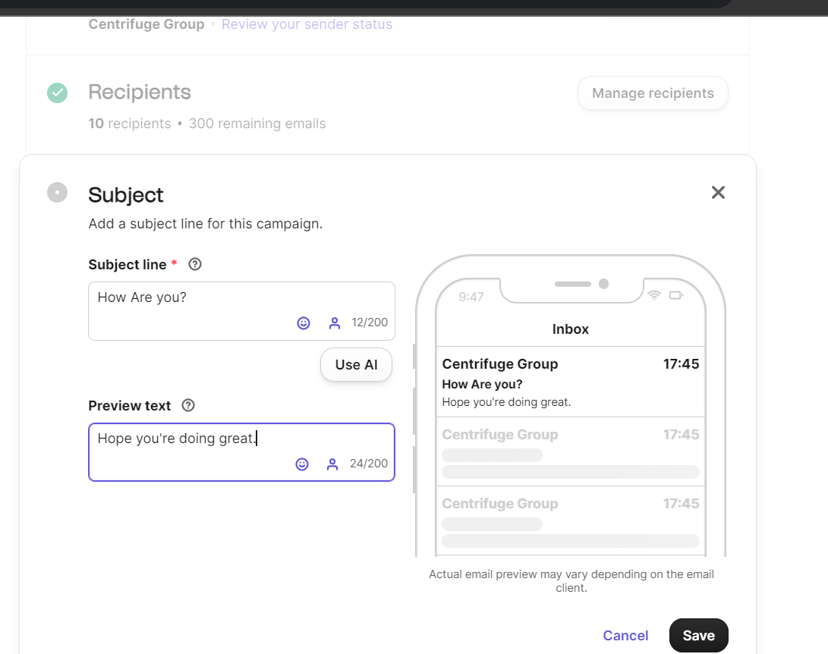
Choosing Email Subject line and Preview text.

Slide 22
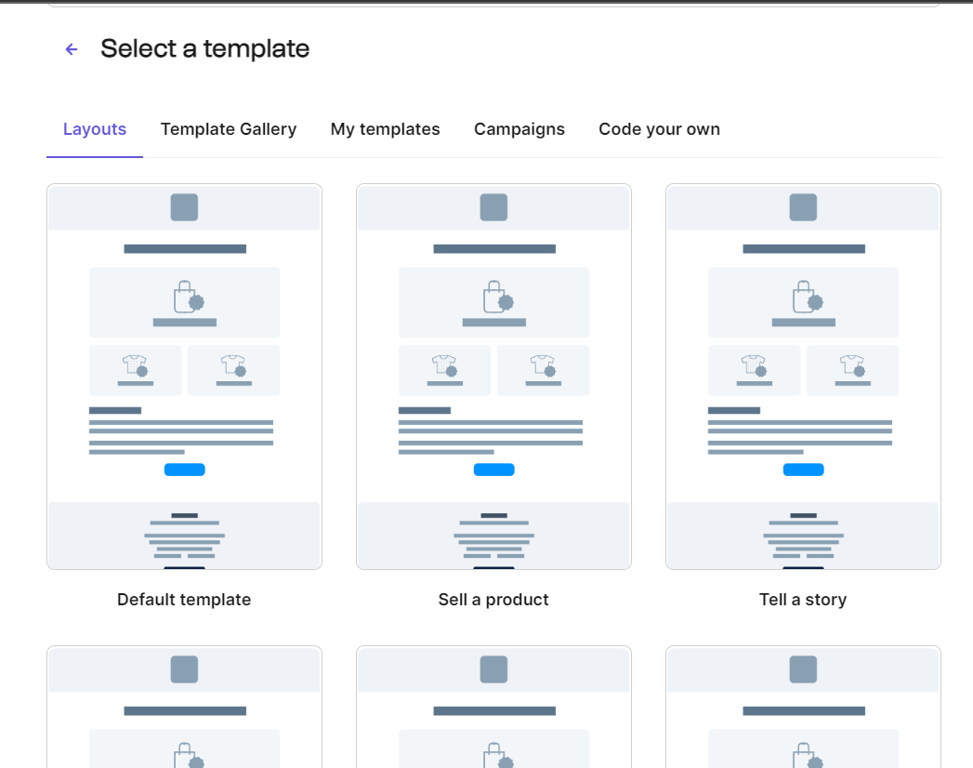
Choose Your Preferred Email Template.

Slide 23
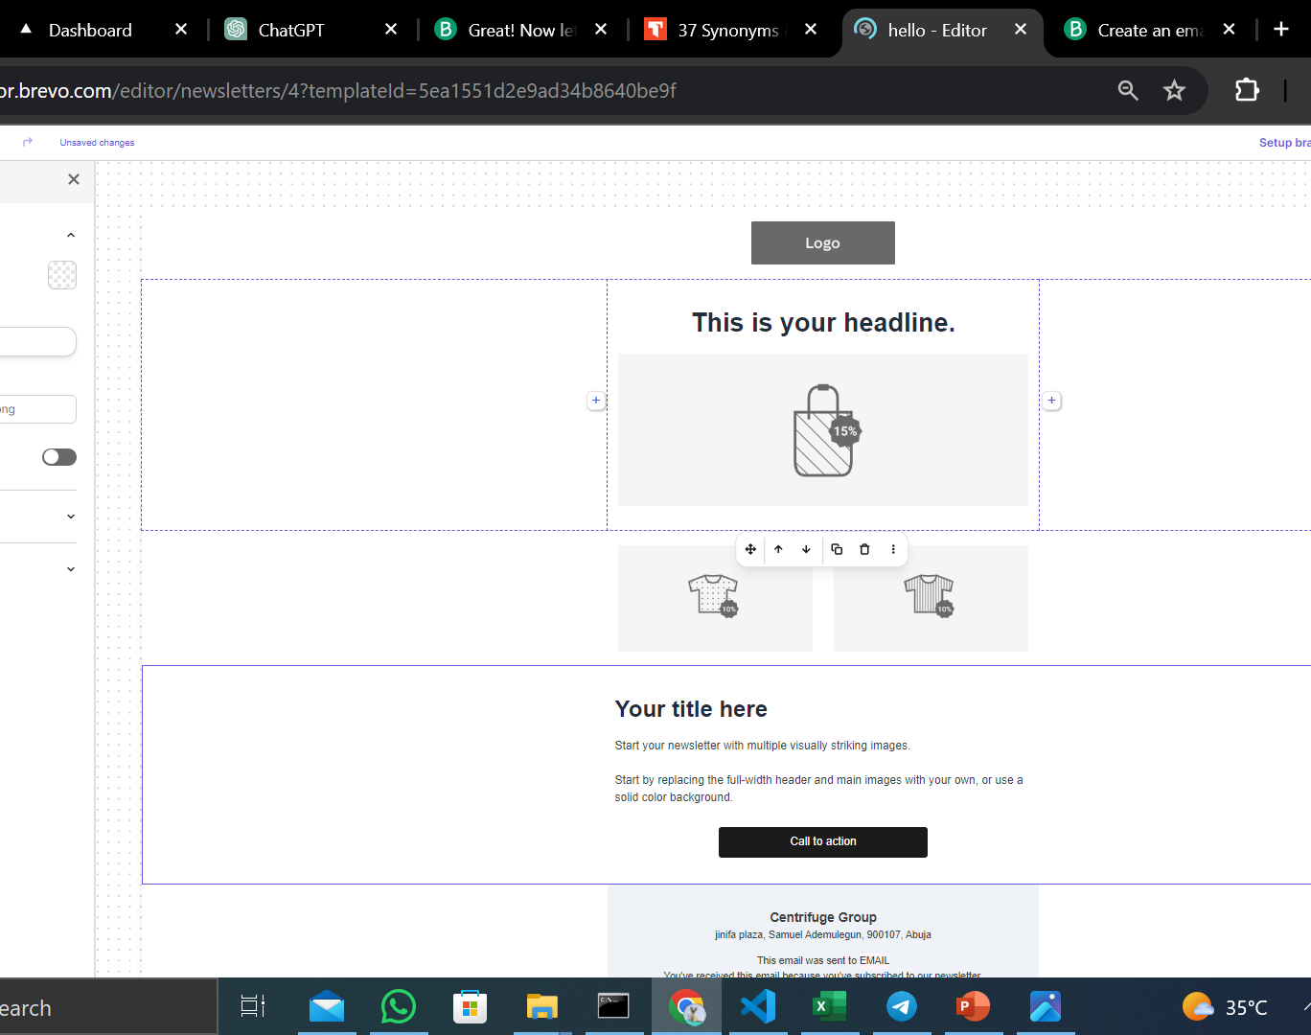
Edit the Body of the Email.

Slide 24
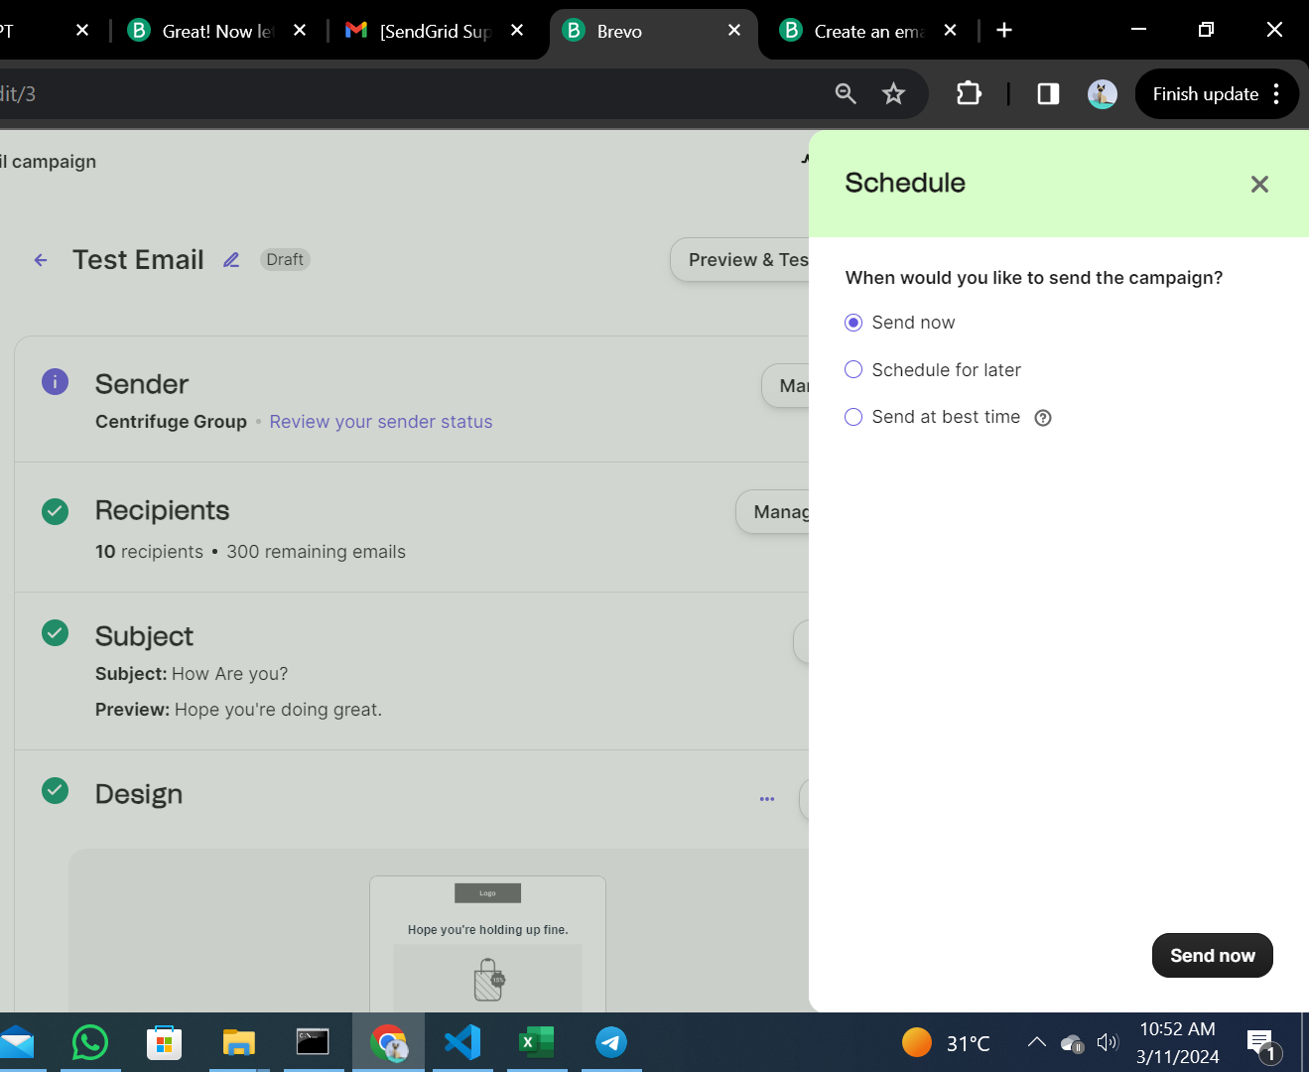
Schedule when you want your Email sent.

Slide 25
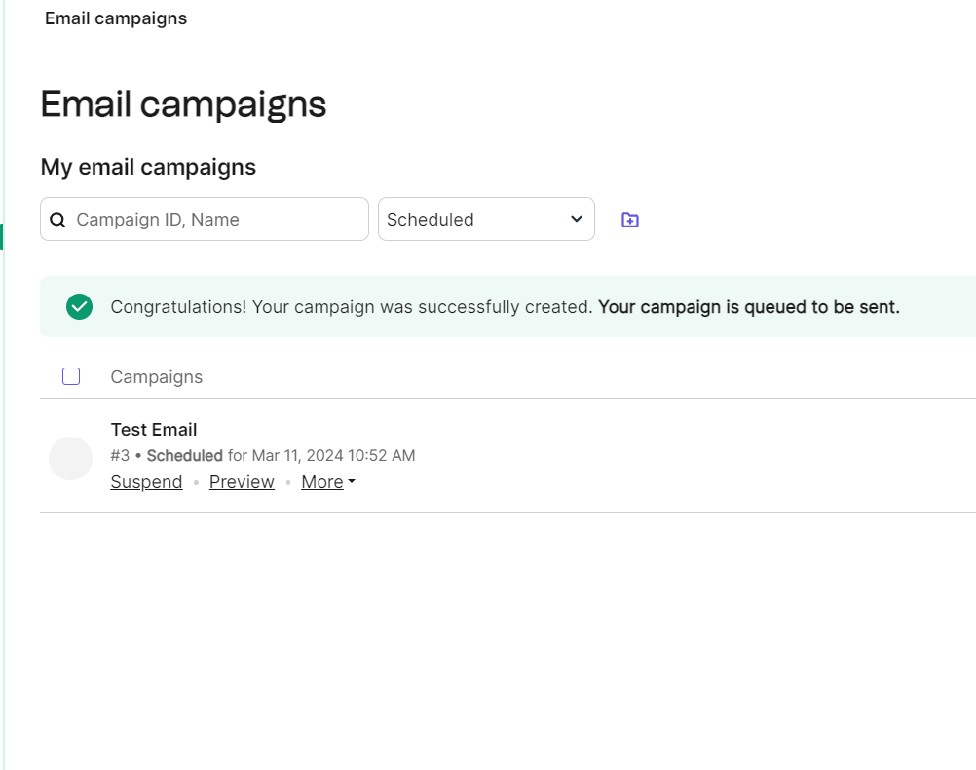
Email Sent.

Slide 29
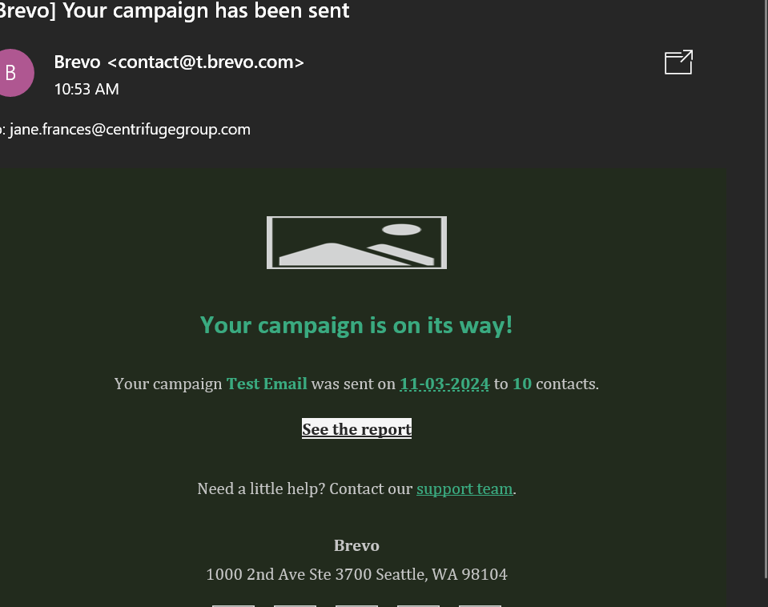
Email Sending Success Notification.

